Slide 1
Macao Bus Travel Time Prediction Using Neural Network
Chris Zhou
Project number:24
p1507881

Slide 2
Outline
Introduction
Background and related work
Design Approach
Implementation
Results and Discussion
Conclusion and Further Work

Slide 3
1. Introduction
the highest population density in China
More and more tourist
Small city with narrow road
Cause big trouble to public transport
For example, unstable bus travelling time, Route 3

Slide 4
1.1 Objective
A web-based application for predicting Macao bus travelling time by neural network, allowing user to choose some traffic conditions (as input parameters) such as weather, weekday, the time of the day.
Build a workable neural network
Collecting data from “Bus Traveling System” and training the network by it
Set up a web server/middleware for connecting neural network and website
Make an good interface in the website, allowing user to select the traffic conditions (input parameters)

Slide 5
2. Background and related work
2.1 Population and public transport in Macao
2.2 Big Data
2.3 Neural Network
2.4 The main software tools used
2.5 Related work

Slide 6
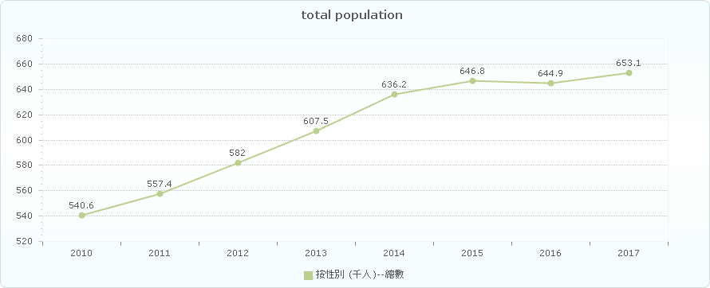
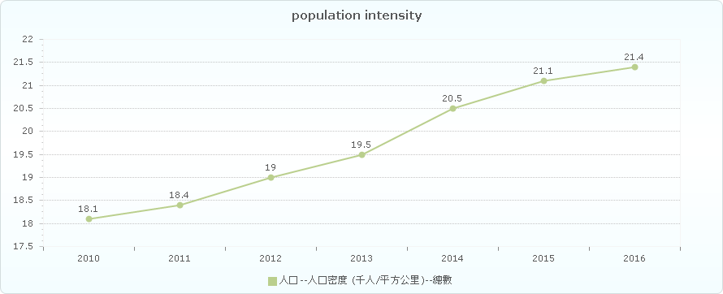
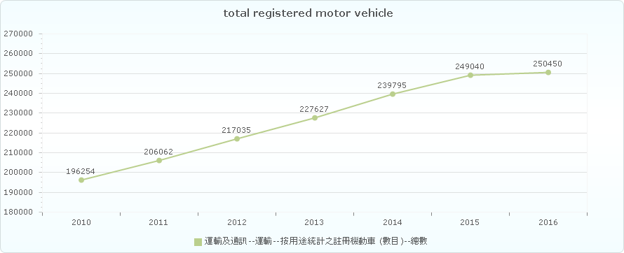
2.1 Population and public transport in Macao
All the figures below are taken from the statistical database of DSEC [6] (Statistics and Census Service) in Macao.

Slide 7
2.2 Big Data
Usually be analyzed for better decision & prediction & strategic movement
Three Vs:
Volume: the amount of data is important.
Variety: various kind of data.
Velocity: the speed rate of processing data.

Slide 8
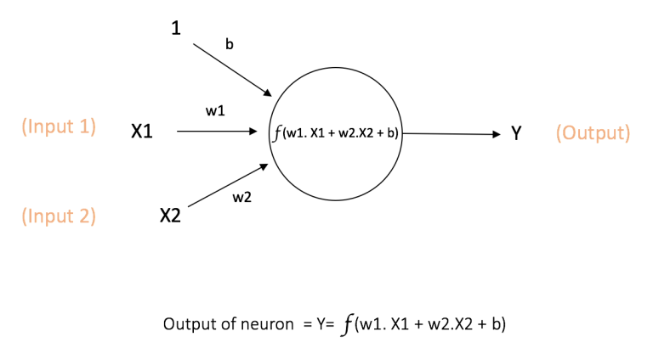
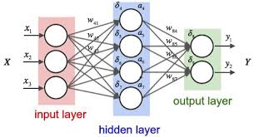
2.3 Neural Network
Information processing model inspired by biologic brain
Training and Learning like human being
More data, more accurate
How it works

Slide 9
2.4 The Main Software tools Used
2.4.1 Pybrain
Machine learning library for Python
offer flexible, easy-to-use and still stronger algorithms
2.4.2 Scikit-learn
Another machine learning library
Simple and efficient tools for data mining and data analysis
Open source, commercially usable

Slide 10
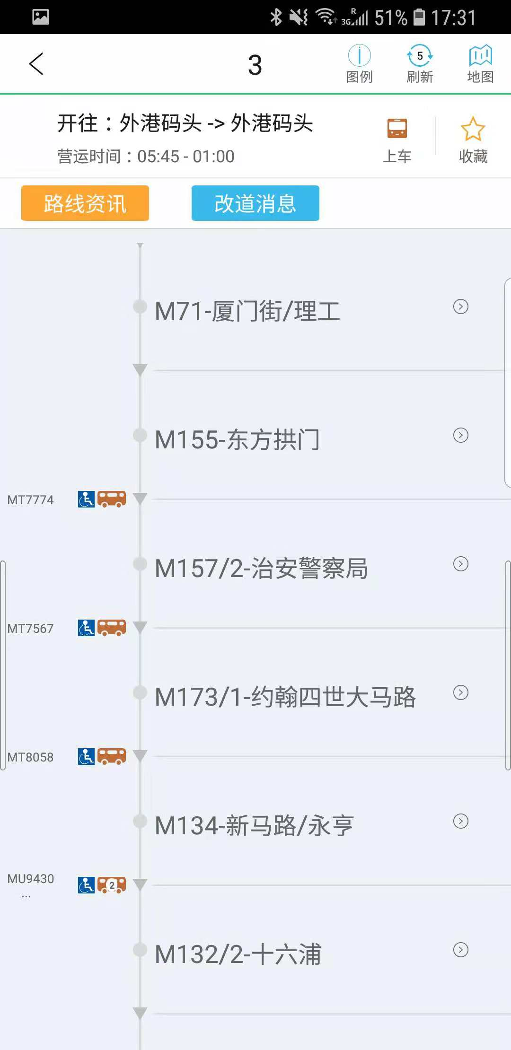
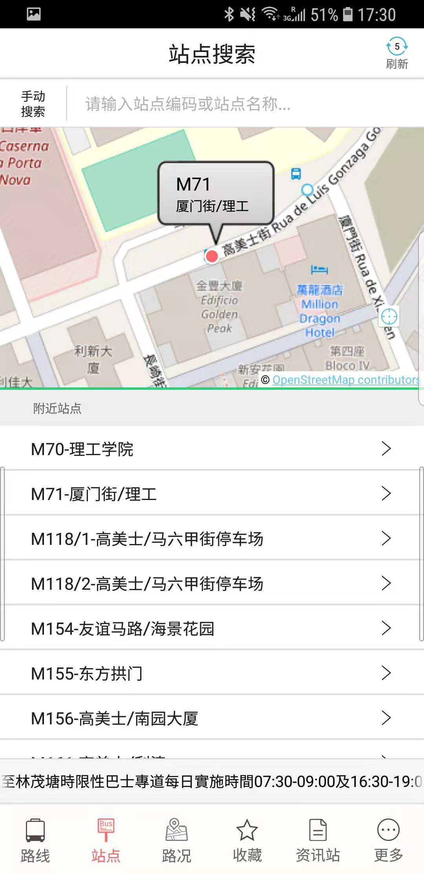
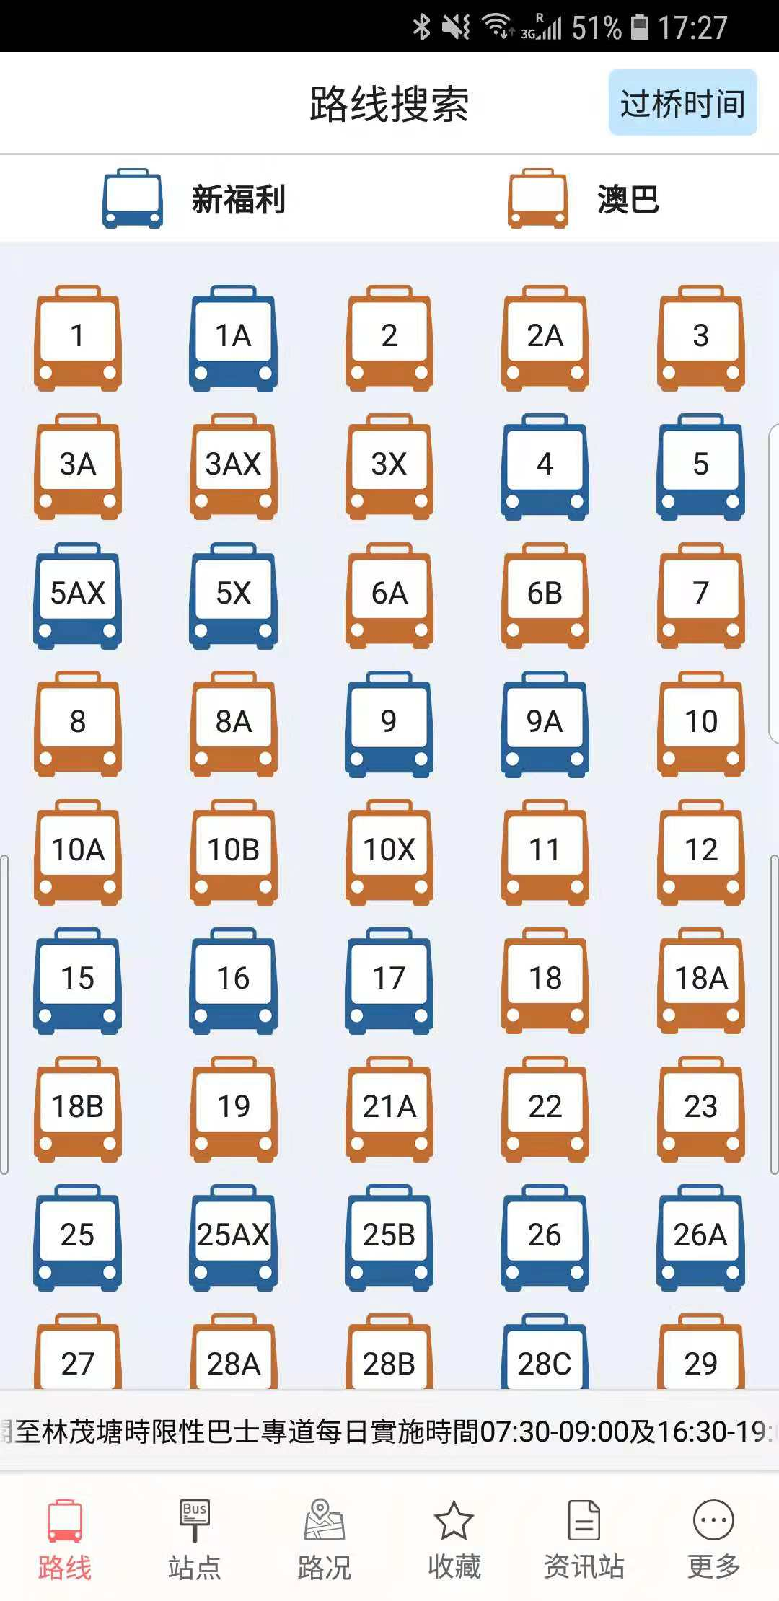
2.5 Related Work
2.5.1 Macao Bus Travelling System
Officially released by DSAT
Information about bus route, bus stop, bus location and so on
No estimated travelling time

Slide 11
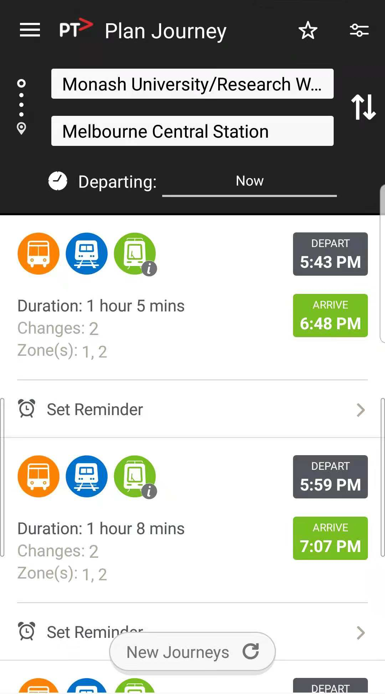
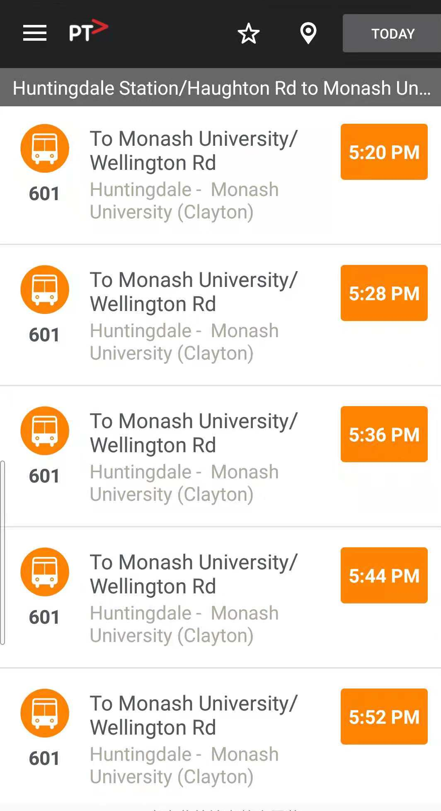
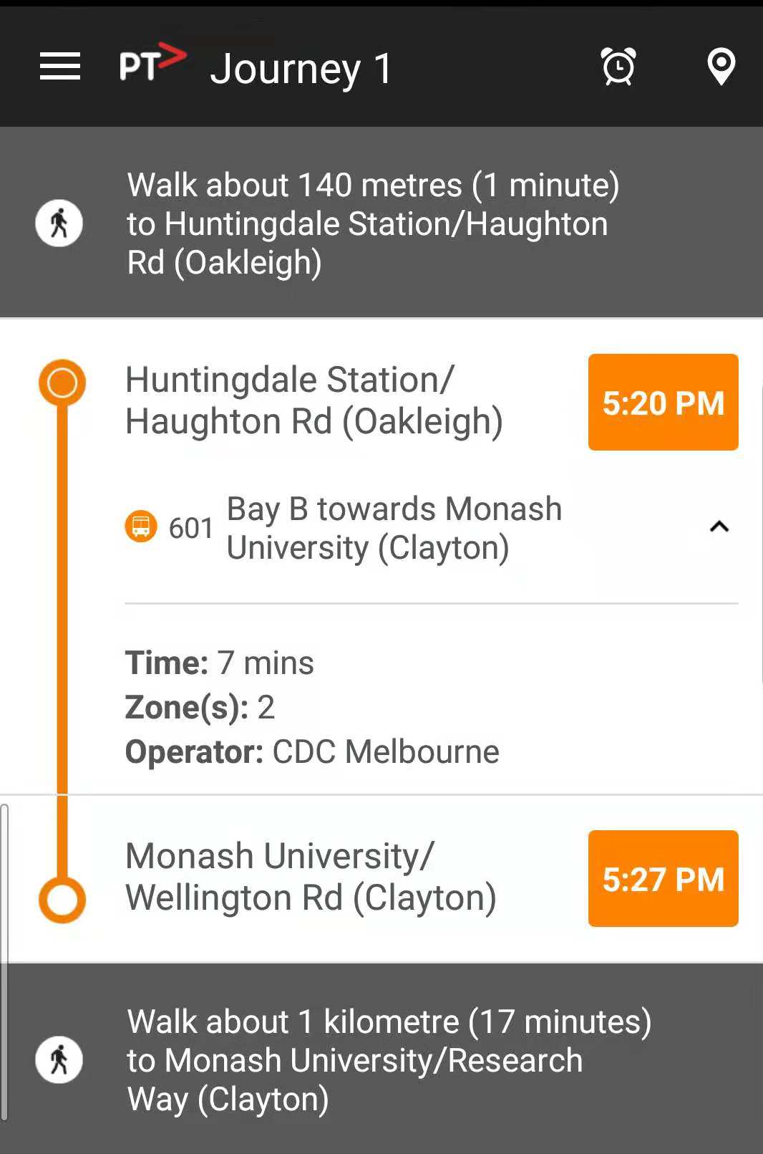
2.5 Related Work
2.5.2 Public Transport Victoria (PTV)
Officially released by Victoria government, Australia
Support 3 kind of vehicle: Train, Tram and Bus
Provide any public transport information such as services, fares, tickets and so on
The estimated travelling time is based on a fix timetable and cannot change it dynamically

Slide 12

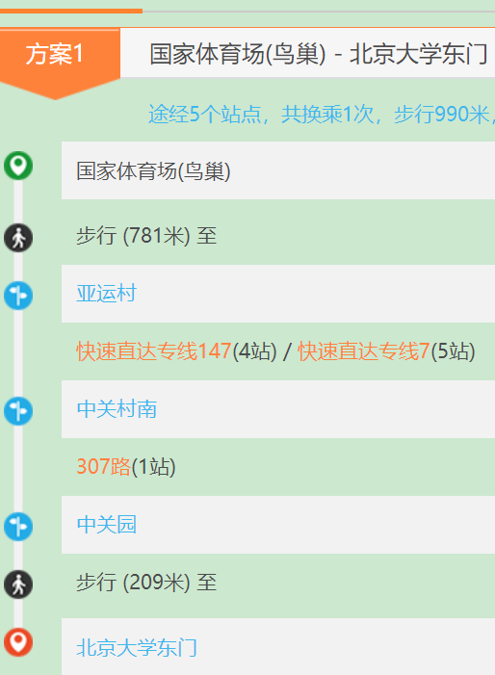
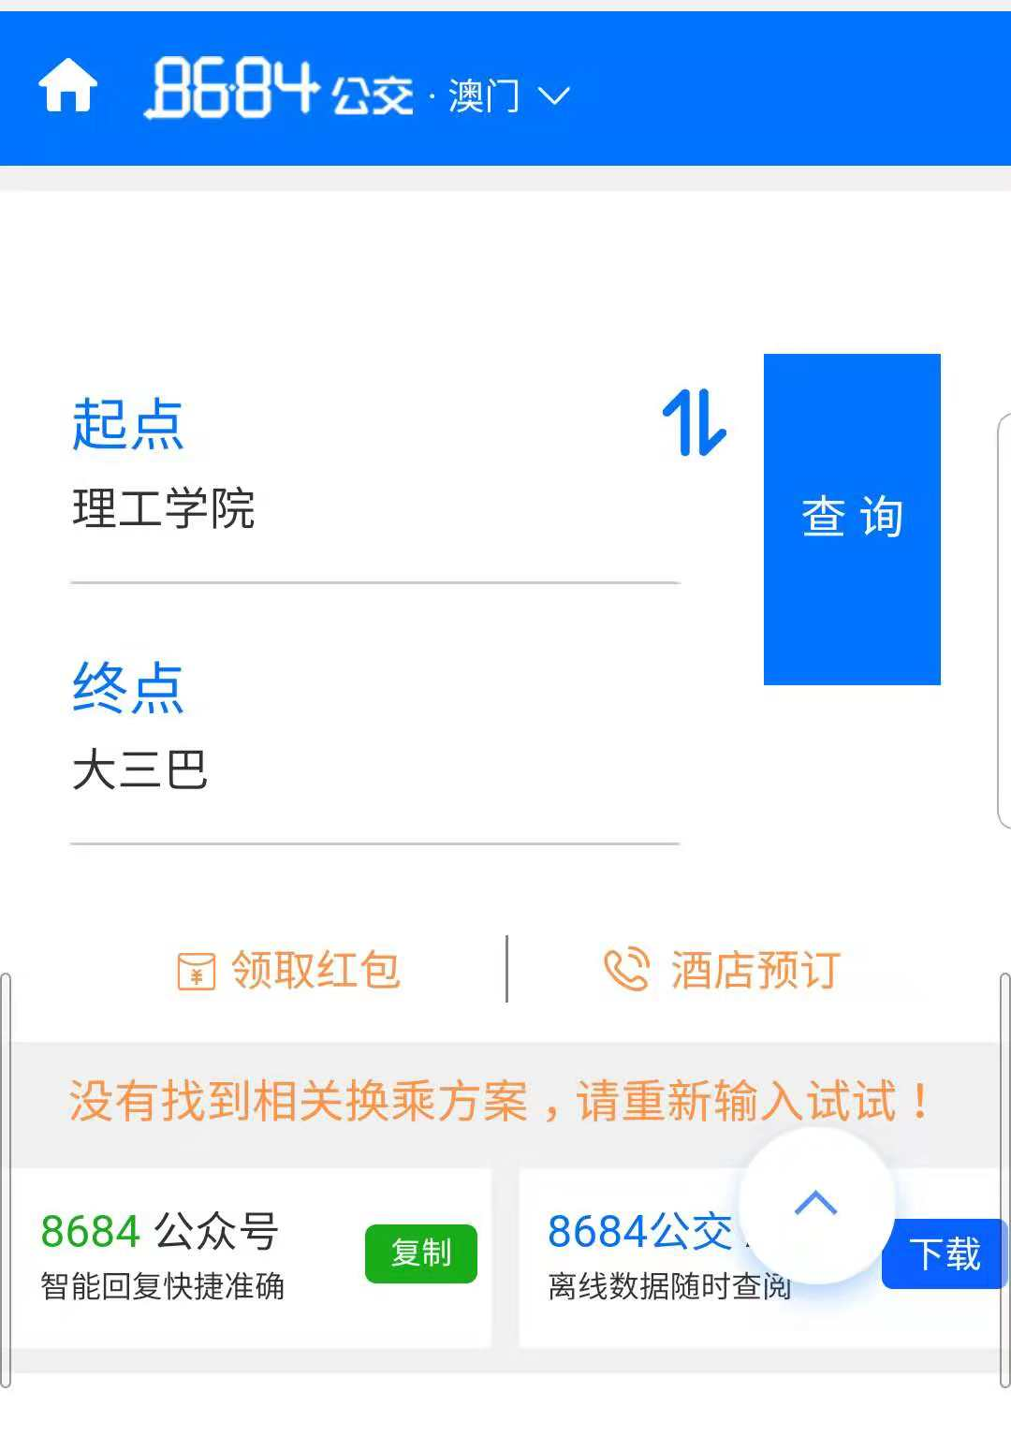
2.5 Related Work
2.5.3 8684.cn
A public transport searching system for mainland China
Travelling information of bus, train and plane.
Provide a detailed plan for user
No estimated time
Doesn’t support Hong Kong and Macao

Slide 13
3. Design Approach
3.1 System Structure
3.2 Neural Network
3.3 Web Framework

Slide 14
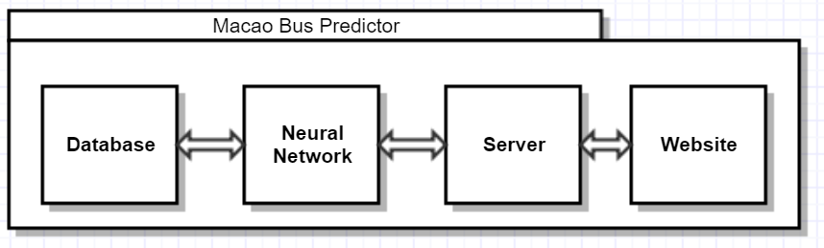
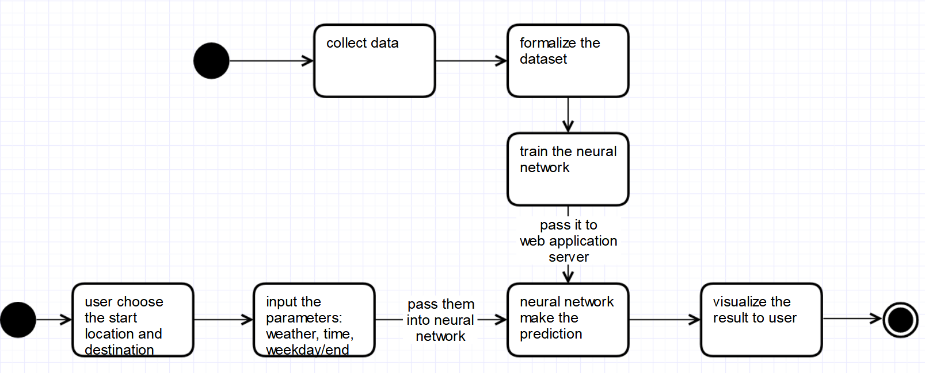
3.1 System Structure

Slide 15
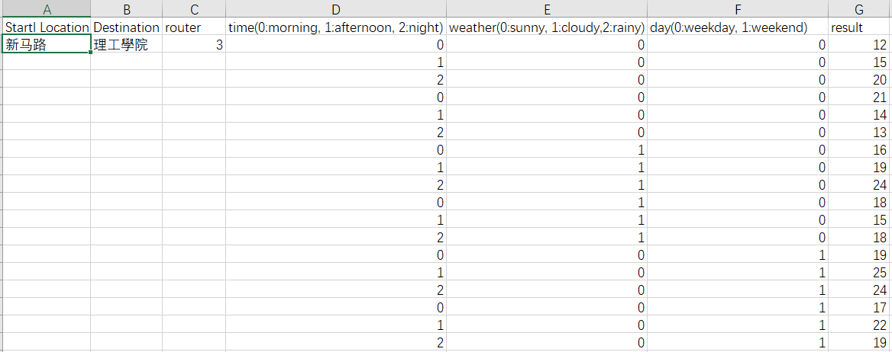
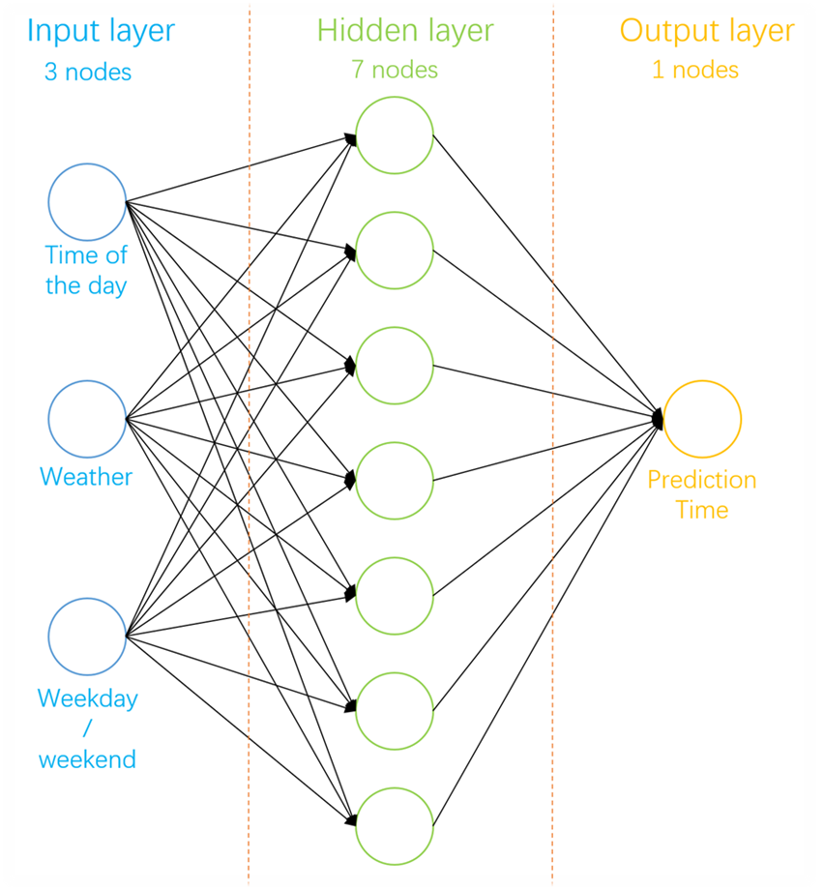
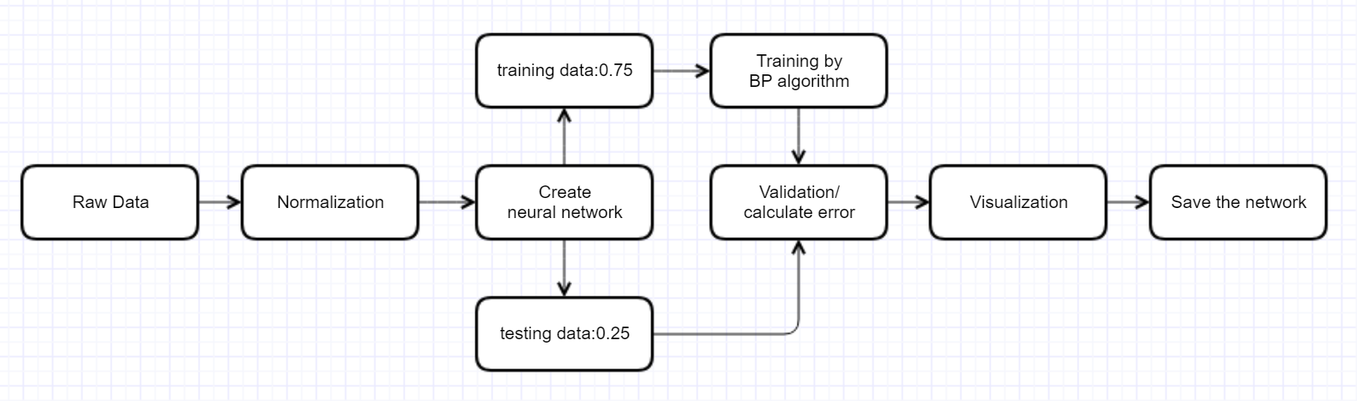
3.2 Neural Network
Structure of Dataset
Creation of Neural Network

Slide 16
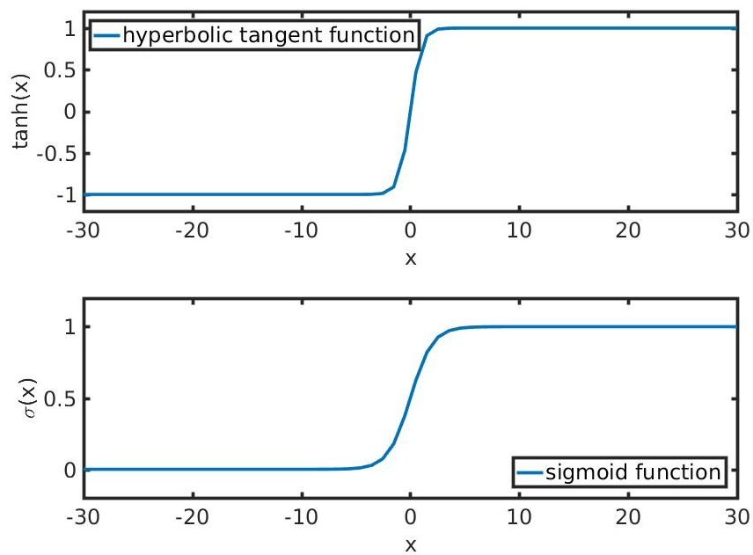
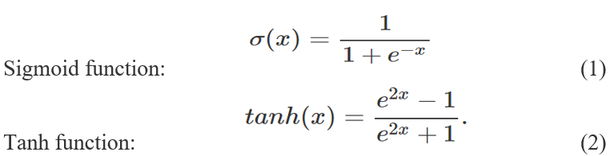
3.2 Neural Network
Parameter Setting
Training algorithm: Back propagation
Store and Load

Slide 17


3.2 Web Framework
In order to build a website which suits both computer and smartphone, a good web framework is needed.
Front-end: Bootstrap
Back-end: Flask

Slide 18
4. Implementation
4.1 Software Tools
Neural Network Library: PyBrain
Web Framework: Flask
Interface: Bootstrap
Public IP address: Ngrok

Slide 19
4.2 Neural Network Implementation

Slide 20
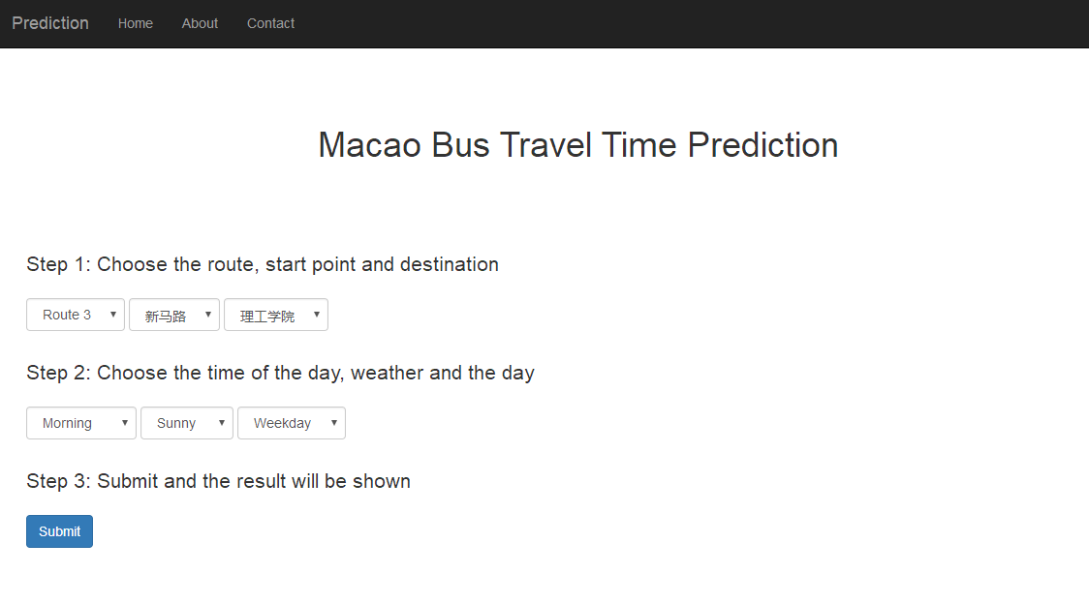
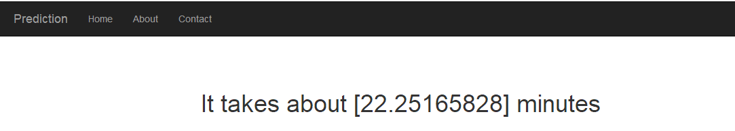
5. Result and Discussion
5.1 Project Outcome
5.1.1 Computer-side

Slide 21
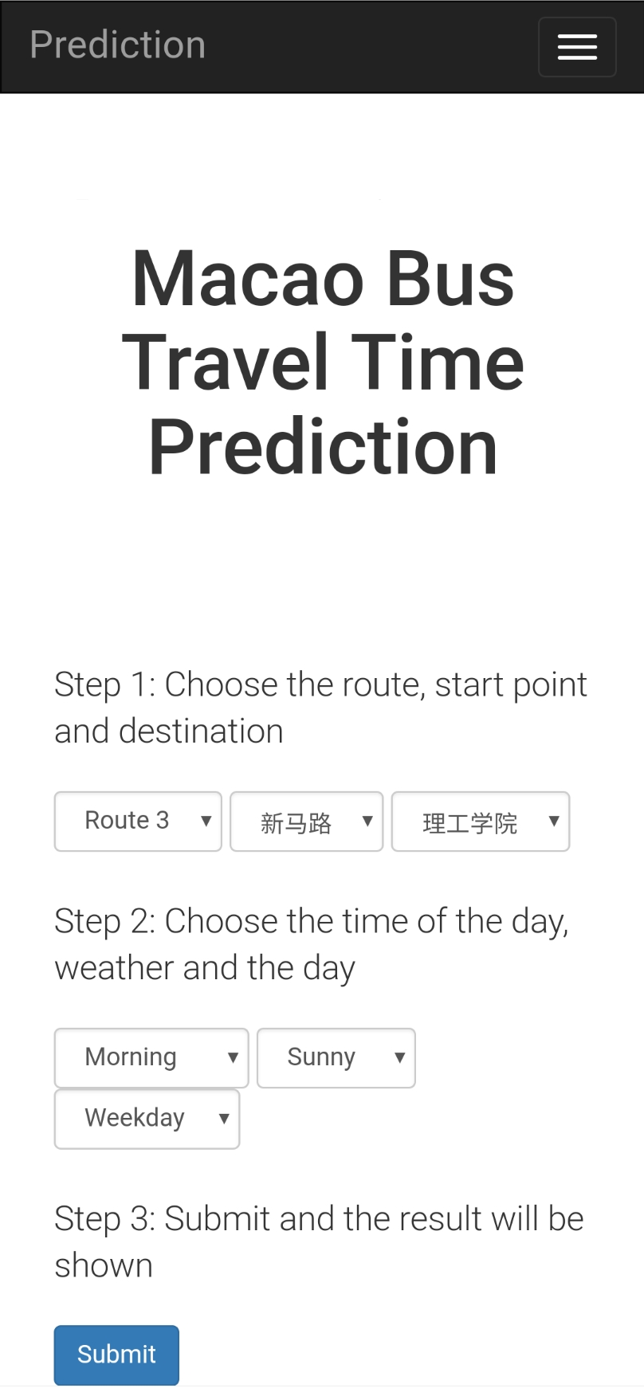
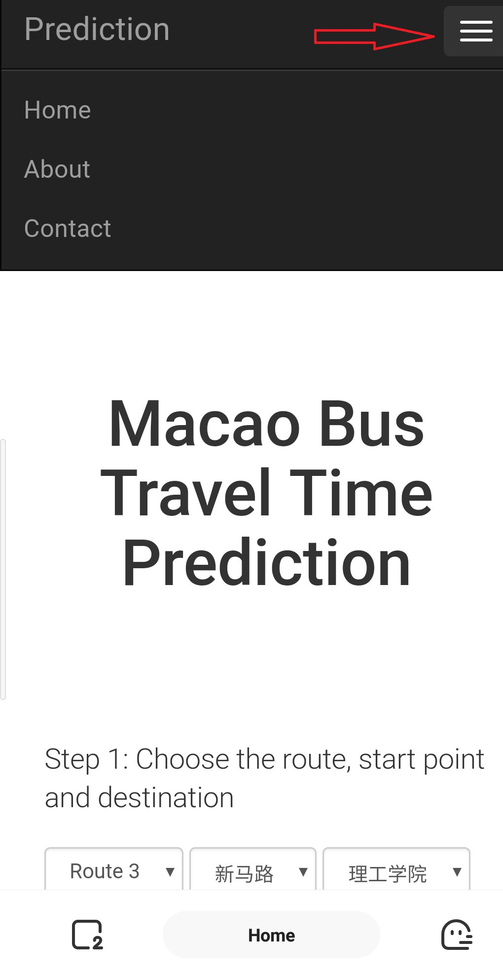
5.1 Project Outcome
5.1.2 Mobile-side

Slide 22
5.2 Testing and Analysis

Slide 23
6. Conclusion and Further Work

Slide 24
The end! Thank you! Q&A

